Slide 1
Rural Housing Service
Section 514 and 515 Rural Rental Housing
Maturing Mortgages
Dan Garcia-Diaz, Director
Holly Hobbs, Analyst
2018 CARH Annual Meeting & Legislative Conference
June 19, 2018

Slide 2
Researchable Questions
Our work examined RHS’s efforts to
(1) estimate the dates that properties may exit the rural rental housing programs due to mortgage maturity and
(2) preserve the affordability of rural rental properties with maturing mortgages
Scope: Section 514/515 financed properties and Section 521 rental assistance
Notes:
Senate Agriculture Appropriations

Slide 3
Background—Portfolio Composition
June 2017 RHS data showed that the program had approximately 14,000 properties containing 427,000 rental units.
Approximately 12,000 properties (85 percent) and 282,000 units (66 percent) received rental assistance.
The agency has not financed any new rental housing properties since 2011.
Instead, RHS has generally used program funding to repair and rehabilitate existing program properties.

Slide 4
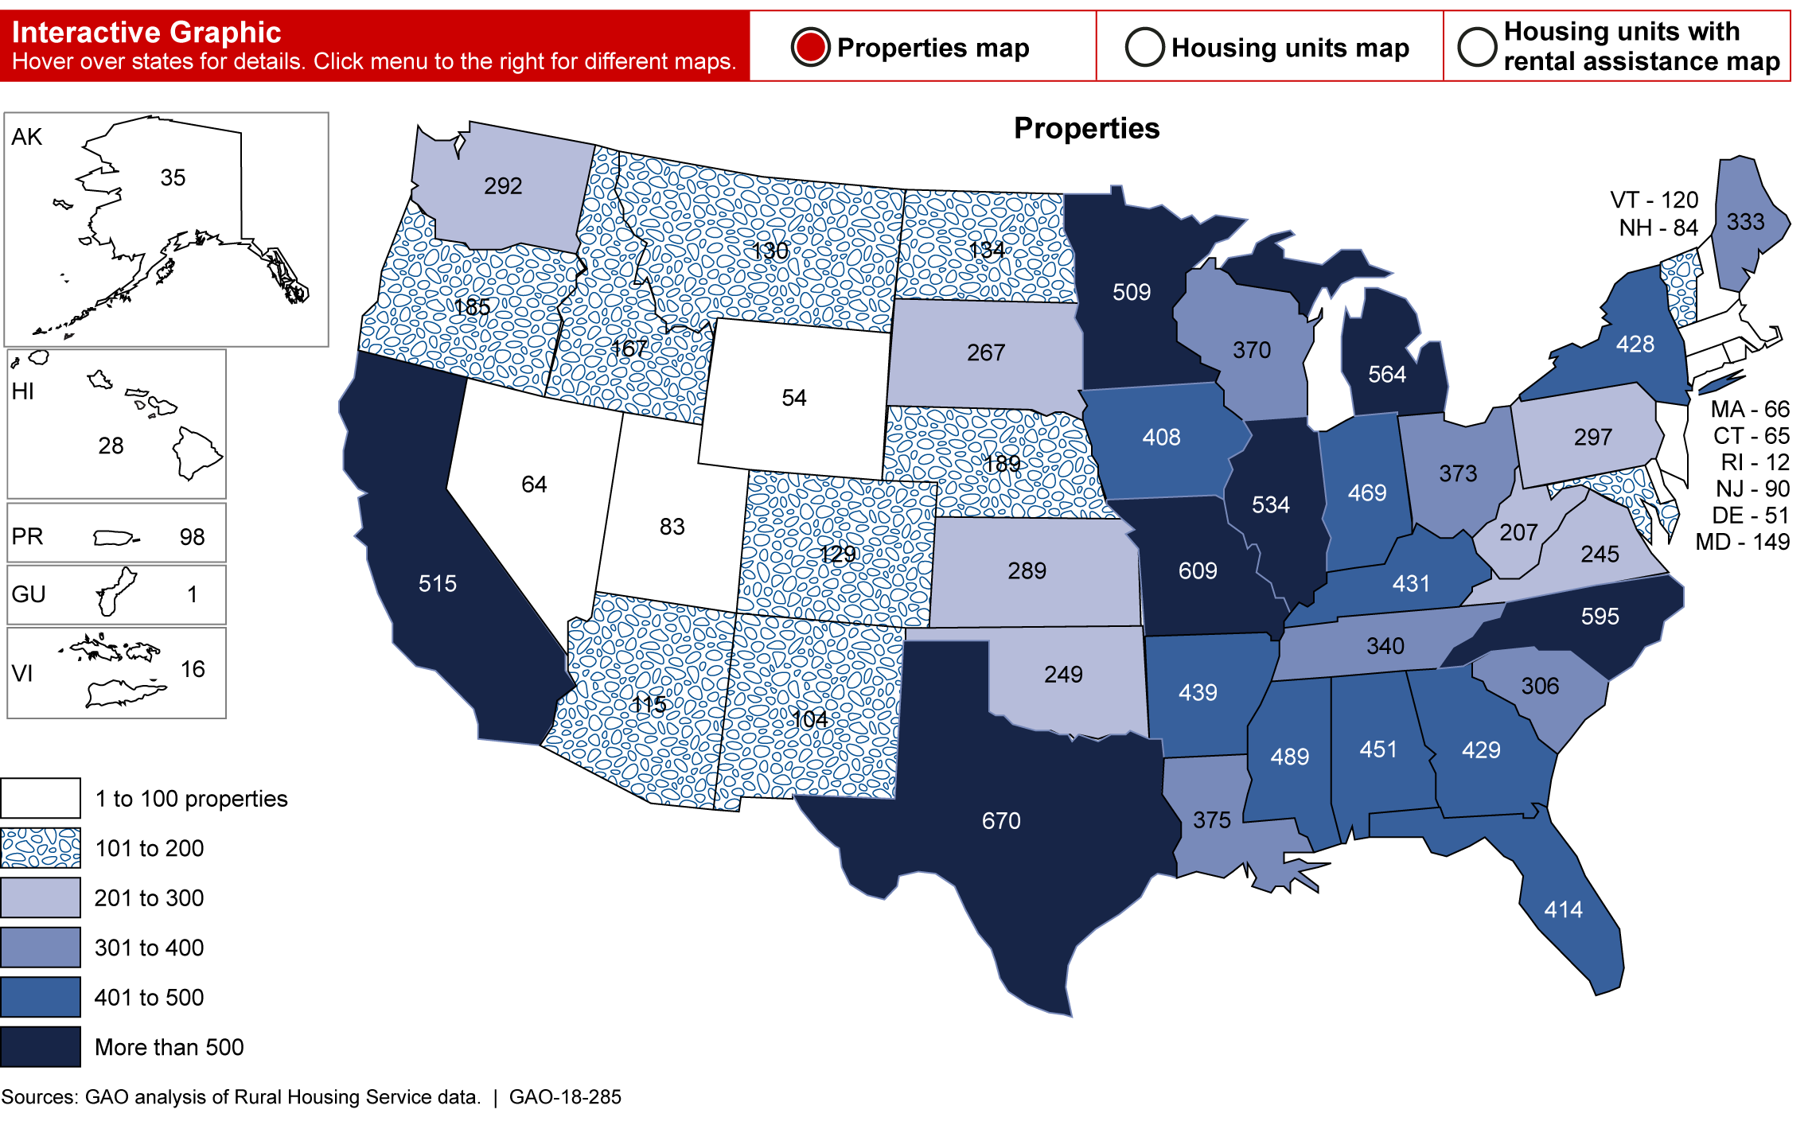
Number of RHS Properties by State
Notes:
The Midwest and South may be particularly hard hit by properties with maturing mortgages and possible property exits.
As the map shows, states like California, Texas, Minnesota, Illinois, Michigan, Missouri, and Virginia have large number of RHS rural rental housing properties.

Slide 5
Background—Exiting the RHS Portfolio
Properties with RHS rental housing mortgages can exit the program in three ways:
foreclosure,
prepayment, and
natural maturity of the mortgage.
Key challenge:
RHS cannot continue rental assistance at a property once the mortgage matures.
RHS can only offer vouchers to tenants when an owner prepays the mortgage or when a property is foreclosed.
Loss of deep subsidy for low-income tenants.
Notes:
Three ways properties can exit the portfolio:
(1) Foreclosure -- When an owner defaults on loan payments and the property is foreclosed, it may exit RHS’s program.
(2) Loan maturity -- Loans mature naturally, meaning the loan is paid off as scheduled by the original loan term.
(3) Prepayment – Loans can be prepaid, meaning payments are made ahead of schedule, which ends the loan term early.

Slide 6
Finding 1: RHS’s Property Preservation Tool and Property Exit Data
In March 2016, RHS developed the Multi-Family Housing Property Preservation Tool (preservation tool), an electronic system designed to estimate mortgage maturity and property exit dates and to calculate new dates that may result from RHS’s preservation efforts.
Preservation Tool is publicly-available on the Internet at: https://public.tableau.com/profile/greg.steck7461#!/vizhome/USDARuralDevelopmentMulti-FamilyHousing/Overview

Slide 7
Preservation Tool
Replaces RHS’s old method of manually calculating property exit dates.
Enhances data capability, including property exit date, property characteristics, and receipt of RA assistance, etc.
As of April 2018, RHS had estimated property exit data available from 2017 to 2050, but not information on properties whose mortgages may mature in 2051 or beyond.
Notes:
Enhancements: Searching for the date a property began operating; total number of units; units receiving RHS rental assistance; mortgage amount and interest rate; mortgage prepayment eligibility; and property exit date estimates, among other information.
Identification of trends in property exits across years and when RHS will need to take preservation actions.

Slide 8
Increasing Numbers of RHS Properties Could Exit the Portfolio
Short-term (2017-2027)
About 900 properties (6 percent of the program’s portfolio), including 20,000 units (5 percent) could exit.
Long-term (2028-2050):
Over 13,000 properties (94 percent) and about 407,000 units (95 percent) could exit.

Slide 9
Properties with Potential Mortgage Prepayment
About 35 percent of RHS’s rural rental properties (4,944 out of 14,075 properties) could exit the RHS program ahead of their original mortgage maturity date.
RHS can determine prepayment eligibility, but cannot predict whether or when prepayments will occur.
If an owner prepays, rental assistance is no longer available to assist that property’s tenants.
Earlier exit could ultimately cause tenants to face rent increases or search for alternative affordable housing earlier than expected.

Slide 10
Preservation Tool Limitations
RHS has not developed a regular, timely process for updating the preservation tool’s data.
RHS intended to do quarterly updates because exit dates change in response to RHS preservation efforts or properties decide to exit.
Since developing the tool, RHS was able to update the data twice in 2016, once in 2017, and has not updated it for 2018 (as of May).
Updated information is critical for managing and preserving the RHS rural rental housing portfolio.
Notes:
RHS officials said that they have been unable to update the preservation tool quarterly due to staff attrition and competing program demands across RHS.
Without controls to help ensure that RHS, industry stakeholders, and the public have the most recent data available, they might not have the most current information that could be used for estimating property exit dates and starting preservation.

Slide 11
RHS Data Controls Limitations
First, RHS only retroactively reviewed a sample of loan document information entered into data systems used by the Preservation Tool.
RHS has some data accuracy checks in place and recently improved the specificity of these checks.
We found a limited number of errors (3 to 5 percent) in key variables such as mortgage amounts, closing dates, and repayment periods for properties in five states we examined.

Slide 12
RHS Data Controls Limitation (cont’d)
Second, RHS lacked controls to check the accuracy and completeness of underlying data (which is available on RHS’s website) used by the preservation tool.
Low overall error rate.
However, some key information used to estimate property exit dates was missing.
Third, RHS has not yet developed a control process to identify potential issues with its underlying data, despite developing and implementing the tool since 2016.
Notes:
Second, RHS lacked controls to check the accuracy and completeness of underlying data (which is available on RHS’s website) used by the preservation tool.
Low overall error rate.
However, some key information used to estimate property exit dates was missing: property address; property state; borrower address; and management company name information.
Third, RHS has not yet developed a control process to identify potential issues with its underlying data, despite developing and implementing the tool since 2016.

Slide 13
Finding 2: Addressing Maturing Mortgages
RHS has taken steps to preserve properties with maturing mortgages:
Developed the preservation tool to track mortgage maturity,
Commissioned studies on issues facing the portfolio such as growing capital needs and the impact of maturing mortgages,
Offered preservation options to owners (loan reamortization, deferral, prepayment, and property transfer)

Slide 14
Options for Preserving Properties and Protecting Tenants
Notes:
RHS offers options in an order.
First requesting that owners reamortize their loans to continue the mortgage and flow of RA to properties.
Second, RHS will offer a loan deferral, typically paired with capital funds under MPR
Third, if owner turns down options, RHS will ask owner to prepay, which allows the agency to offer additional incentives to retain the property (increased RA units, equity loans, increased returns on investment).
Finally, if all that fails…

Slide 15
RHS has not Comprehensively Planned to Preserve Properties with Maturing Mortgages
Lacked documented goals for preserving its program and has not created measures for tracking progress toward those goals.
Was not monitoring and assessing options and incentives it is providing in a way that would inform or improve the use of these options.
Did not fully analyzed or responded to the risks facing its rural rental housing program.
Notes:
Risks include (1) Owner behavior—RHS officials told us a key risk to preserving its rural rental housing program is that the agency cannot predict whether owners will choose to leave the program or stay. (2) Resource constraints—RHS does not have the financial ability to preserve all properties with MM, but have not planned for how it will prioritize the use of limited resources. (3) Management of MM – RHS has seen a lot of turnover and attrition in staff, but are not preparing remaining staff or aligning staff resources to manage MM. (4) Property rehabilitation costs –RHS knows property condition is a factor in an owner’s decision to stay or leave the portfolio, but is not planning for how it will address $5.6 billion in capital needs.
Emphasize RHS is in a reactive/passive mode.

Slide 16
Probable Effect of Limited RHS Planning
Officials said RHS has not fully planned because maturing mortgages will peak after 10 years (2028).
Yet, high percentage of exits suggest current planning efforts are insufficient.
Year | Percentage of properties with maturing mortgages that exited, by year
2014 | 71%
2015 | 63%
2016 | 58%
2017 | 60%
Average | 61%
Notes:
While some owners may choose to leave the program regardless of options and incentives RHS offers, the high percentage of exits between 2014-2017 suggest current planning efforts are not sufficient.

Slide 17
Congressional interest in expanding tenant protections
In 2016, H.R 4908 would have allowed RHS to continue providing rental assistance to properties after loans matured or to provide vouchers to tenants under different circumstances, including mortgage maturity.
An identical bill (S. 2783) was introduced in the Senate in 2016.
Congress has taken other actions to protect tenants: For example, beginning in FY 2006, Congress authorized RHS to provide vouchers to tenants affected by loan prepayments.
Notes:
H.R. 4908 (114th Congress), Rural Housing Preservation Act of 2016, April 12, 2016:
In exchange for accepting rental assistance payments on behalf of eligible tenants, the legislation would have required the property owners to enter into an agreement with RHS to ensure that the property remained subject to low-income use restrictions for an additional period of time. No action on this legislation was taken.
An identical bill, S. 2783 (114th Cong.), was introduced in the Senate at the same time. As with H. R. 4908, no action was taken on S. 2783.
In 2011, Congress created Rental Assistance Demonstration (RAD).
Before the RAD program, HUD had limited authority to extend rental assistance at these properties when contracts expired or owners terminated contracts.
RAD allowed HUD to continue providing rental assistance to property owners after the original contracts expired.
Rental assistance contracts under programs that use RAD were similar to RHS’s Section 515.

Slide 18
Recommendations
Establish additional data controls to ensure accuracy
Create a process for regularly updating Preservation Tool data
Develop performance goals and measures for its preservation efforts
Monitor the results of its preservation efforts
Identify, analyze, and respond to risks to achieving its preservation goals
Notes:
1. Establish additional controls to check the accuracy of all loan information entered into RHS information technology systems, to help ensure complete, accurate, and reliable data for estimating rural rental housing property exit dates.
2. RHS should establish a process to help ensure regular and frequent updates for the preservation tool and its underlying data.
3. Establish performance goals and measures for its rural rental housing preservation and rehabilitation efforts and report out these outcomes.
4. Monitor the results of rural rental housing preservation efforts and assess the degree to which those efforts yielded intended outcomes.
5. Identify, analyze, and respond to risks to achieving its preservation goals, including resource and staffing limitations.

Slide 19
Matter for Congressional Consideration
For RHS properties whose mortgages have matured, Congress should consider granting RHS the authority to
renew annual rental assistance payments to owners who wish to continue to receive them and
provide vouchers to tenants living in rental assistance units in properties whose owners choose to no longer receive rental assistance.

